Slide 1

Error Analysis
Cleaning up
Incorrectly labeled data
deeplearning.ai

Slide 2
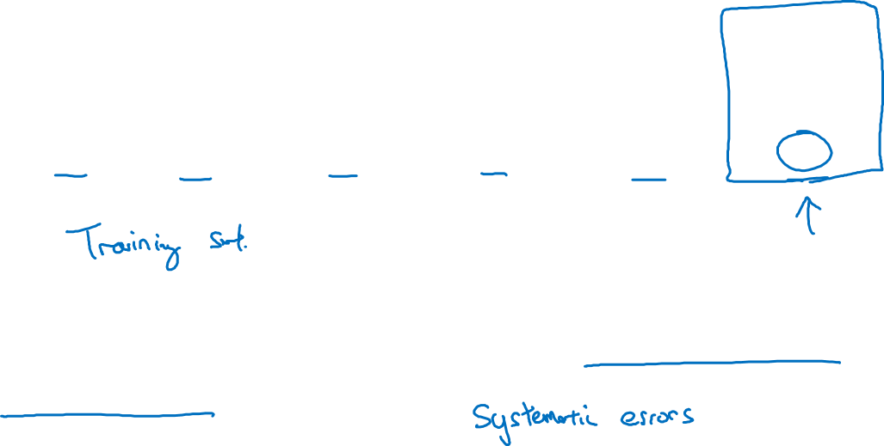
Incorrectly labeled examples
x
y
1
0
1
1
0
1
1
DL algorithms are quite robust to random errors in the
training set.

Slide 3
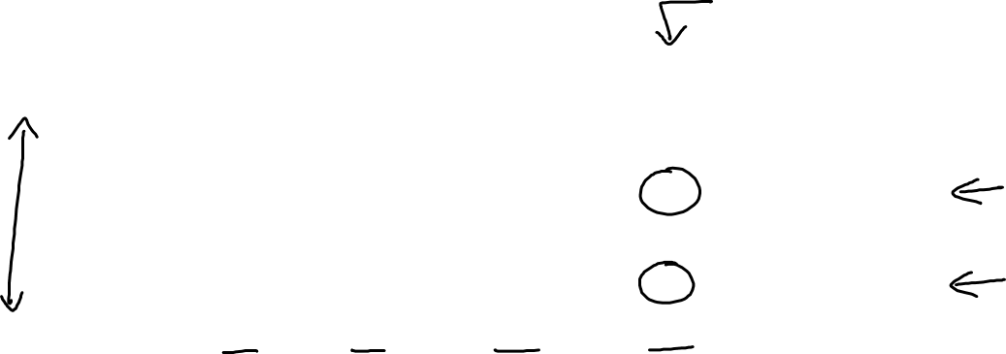
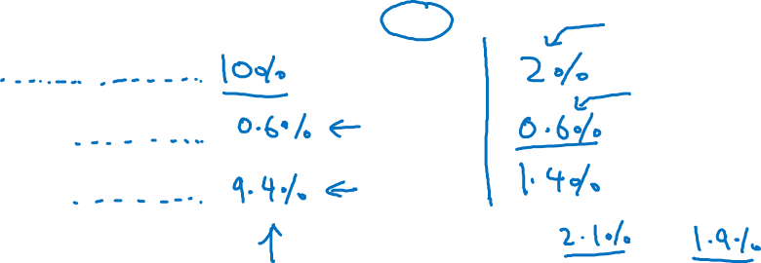
Error analysis
Image | Dog | Great Cat | Blurry | Incorrectly labeled | Comments
…
98 |  |  |  | ✓ | Labeler missed cat in background
99 |  | ✓
100 |  |  |  | ✓ | Drawing of a cat; Not a real cat.
% of total | 8% | 43% | 61% | 6%
Overall dev set error
Errors due incorrect labels
Errors due to other causes
Goal of dev set is to help you select between two classifiers A & B.

Slide 4
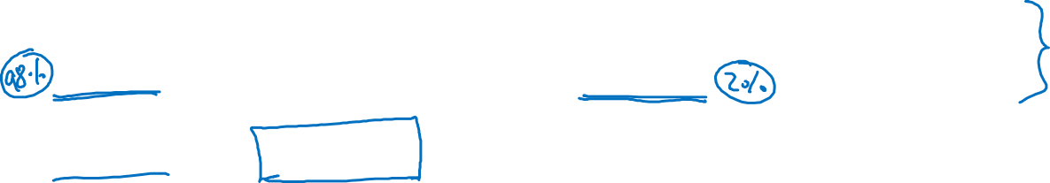
Correcting incorrect dev/test set examples
Apply same process to your dev and test sets to make sure they continue to come from the same distribution
Consider examining examples your algorithm got right as well as ones it got wrong.
Train and dev/test data may now come from slightly different distributions.

